Slide 1
Welcome to Columbia

Slide 2
Columbia University In The City Of New York
Three undergraduate schools:
Columbia College
School of Engineering
School of General Studies
Eleven graduate and professional schools:
Architecture, Planning & Preservation
Arts
Business
Climate
Engineering
Graduate School of Arts & Sciences
International and Public Affairs
Journalism
Law
Professional Studies
Social Work
Medical Center
Global Programs
Notes:
Touch on access to other schools and programs as SPS student

Slide 3
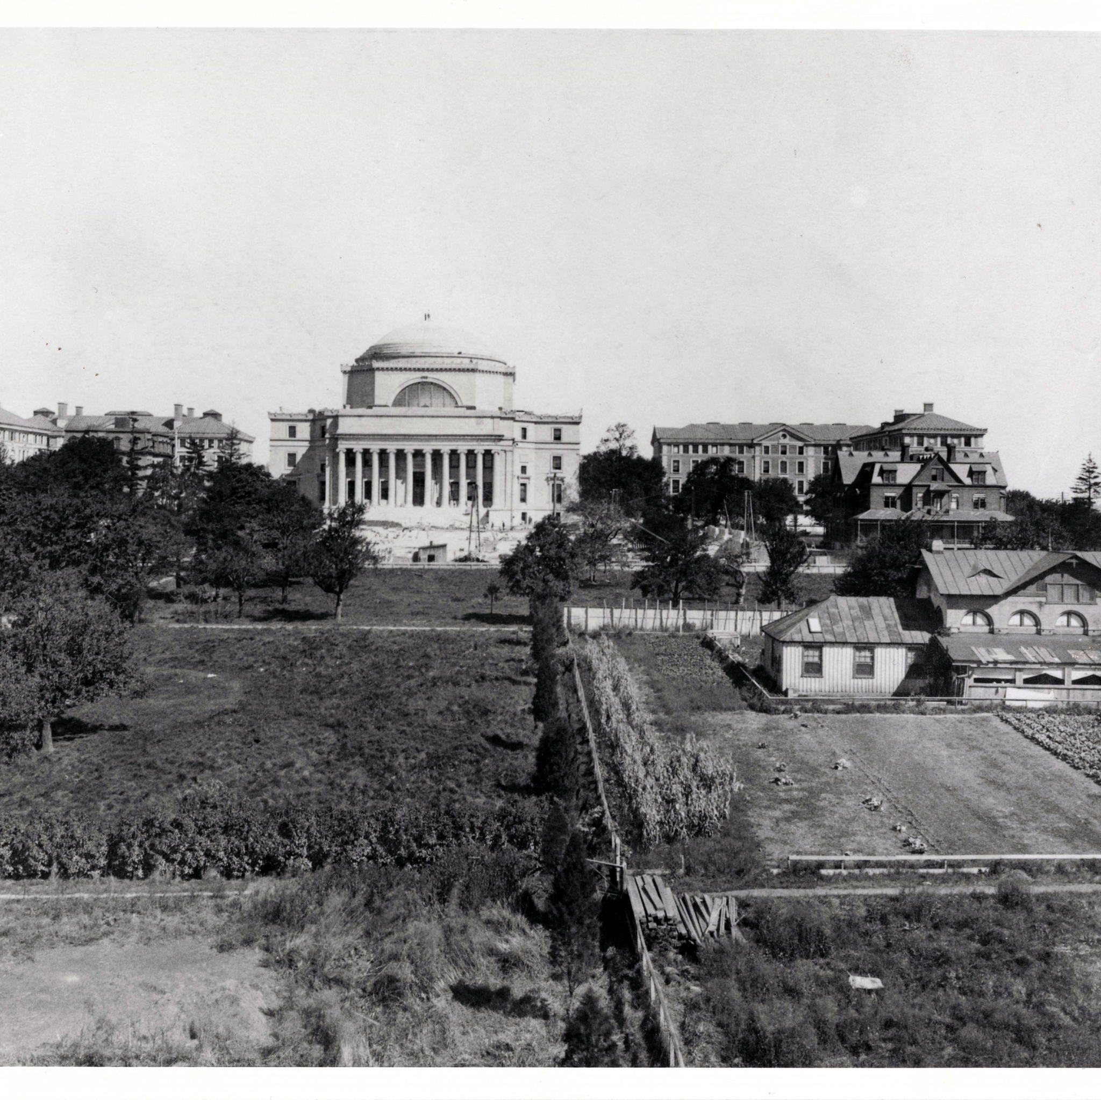
Columbia University in the City Of New York
Founded in 1754 as King’s College by Royal Charter
Oldest institution of higher learning in New York state and fifth oldest in the United States
First classes were held in a schoolhouse adjoining Trinity Church in what is now the Financial District near the World Trade Center
The American Revolution brought classes to a halt for eight years – when the school reopened it was renamed Columbia
In 1784 the name was changed to Columbia and in 1896 the campus was moved here to Morningside Heights
A Place of Double Magic
…a place of “doubled magic,” where “the best things of the moment were outside the rectangle of Columbia; the best things of all human history and thought were inside the rectangle.”
- Alumnus and author Herman Wouk
Notes:
[Note- maybe]

Slide 4
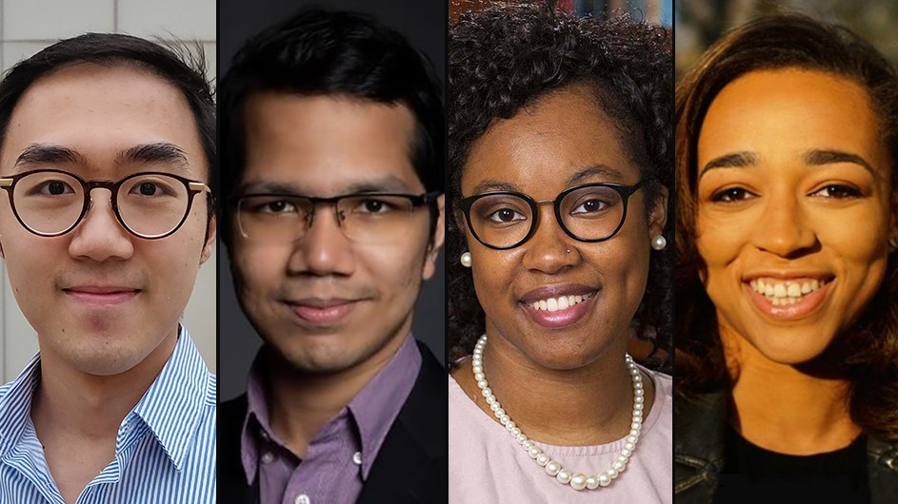
Columbia University in the City Of New York
Recent awards and milestones include:
2024 Rhodes Scholars
Nobel Prize in Chemistry
Three 2023 MacArthur Fellows
2023 Tillman Scholar
Three 2023 McKnight Scholars
Sixteen 2023/24 Fulbright Grants
and so much more
Notes:
[Note- maybe]

Slide 5
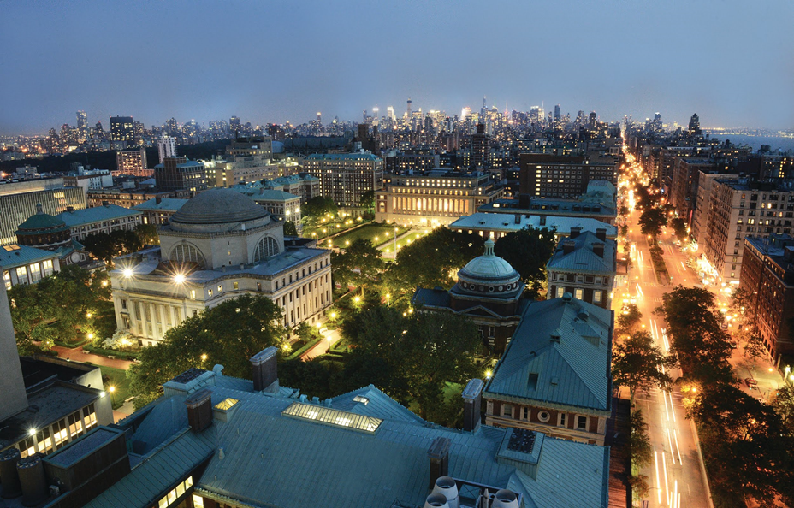
The School of Professional Studies
Mission
As one of the seventeen prestigious schools affiliated with Columbia University, the School of Professional Studies is committed to supporting a diverse community of faculty, students, and staff, while expanding the reach and impact of an Ivy League education so that more students can excel in their careers.
Vision
We build and deliver flexible programs at the highest level for a broad array of people that lead to amazing career and educational outcomes.
Why SPS?
Professional degrees that are market-driven
Scholar-practitioner instructors who are industry leaders in their fields
Flexible course schedules with evening classes available
Small class sizes with strong networking opportunities with faculty, guests and classmates
Notes:
[Note- Maybe]

Slide 6
Why Summer at Columbia?
Shorter time commitment
Smaller class sizes
Flexible course offerings
“Summer-only” programs
Courses led by award-winning faculty, leaders in their respective fields
Take classes with a diverse student population, including CU students
Notes:
So you may be wondering, ‘why should choose to study at Columbia when there are many other summer programs I can take?’ I would like to highlight these main attributes and what makes Columbia in the summer so great.
First, It's a shorter time commitment. The traditional length of a semester during the academic year is about 15-16 weeks long. For summer, our two main sessions are condensed into only six weeks long - less than half the time.
We offer smaller class sizes. Class sizes are smaller in the summer because a number of the Columbia students on campus are going back home, or elsewhere to do internships. These smaller class sizes act as a benefit and allow you more time to speak with your professor and connect with the students in your class.
We have flexible course offerings and offer exclusive summer-only programs and in a few slides, I’ll go into more detail about both of those.
Dormitory housing is available in the summer for the visiting students, which we don’t always offer during the academic year. On campus housing is a great perk to have in a program, because you get to stay near all of the activities and it’s a short walk to your classes.
Other summer programs may separate the visiting students from the matriculated students in the classroom but with our program, everyone is combined. You are studying alongside talented students that study in that classroom during the academic year.
Lastly, Columbia is the only ivy league university in the city of New York. You get the advantage of a great education and fantastic networking opportunities in a vibrant community.

Slide 7
Summer Session Calendar 2024
Summer A | Session X (Full Term) | Summer B
May 20–June 28 | May 20–August 9 | July 1–August 9
Courses may be offered in Summer A, B, or across the full term.
2023 course offerings are posted on the Summer Session website.
Notes:
Note three main options for visiting – full 12-week term and two 6-week sessions
May 15th deadline session 1
June 26th deadline session 2
Fall: June 1st international, July 30th final

Slide 8
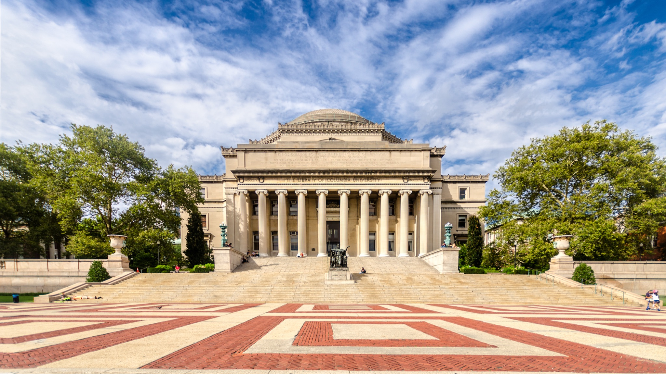
Study Options
Notes:
In front of you is a picture of the historic Low Library, located on Columbia’s main campus where Columbia Summer is hosted.
We are located in northern Manhattan in the neighborhood Morningside Heights. What’s great about our campus is that it’s a little removed from the hustle and bustle of downtown New York City. So you have the classic American campus feel, while also having access to a huge metropolitan city like New York just a few subway stops down.

Slide 9
Visiting Students
How will you be studying at Columbia?
Create a customized program of study with your academic advisor
Choose from more than 300 courses in 50 subject areas: summer.sps.columbia.edu/courses/summer-courses
NOTE: International students with a visa must be full-time during the summer term
6 credits per session (length: 6 weeks)
12 credits per term (length: 12 weeks)
Notes:
As a summer visiting student, you will fall under a specific population that covers your current standing as a student.
· For those currently working towards their Bachelor’s or Master’s and attending university elsewhere, you can apply as a Visiting Undergraduate or Visiting Graduate.
· If you have already completed an undergraduate program, Post-baccalaureate studies may be right for you. The Post-baccalaureate studies program is designed for those who have completed their degree and want to come back and study, enhance their job performance, or perhaps pivot their career and study a new subject area for personal development.
· If you are looking to prepare to return to academia for a Master’s degree, the graduate foundations program can help you. This program is designed with targeted coursework that helps you complete prerequisites and strengthen your academic record.
· For students looking to explore or enhance their creative skillset, you can join us for Arts in the Summer. After completing a short application, you can gain access to Columbia courses in the theatre, film, writing and visual arts.
You will submit an application based on what program and population you fall under, which Cassie will discuss in the admissions portion of this info session later.
If you are in high school currently, please keep in mind the Pre-College Programs are a separate process and we can help connect you with a program advisor.

Slide 10
Summer Courses
Art History Anthropology Astronomy Biology Business Chemistry Classics Classical Civilizations Computer Science Economics English | Ecology, Evolution & Environmental Biology Engineering Film Studies French German History Human Rights International Affairs Italian Journalism | Latin Mathematics Middle Eastern, South Asian & African Studies Music Philosophy Physics Political Science Psychology Quantitative Methods: Social Sciences | Religion Russian Sociology Spanish Statistics Theatre Arts United Nations Urban Studies Writing Visual Arts
Enhance your academic credentials
Choose from more than 300 courses in 50 subject areas
Subjects include:
Notes:
Discuss
• Various subjects
• course schedule
• Course points
• Credit for home institution
• How each course is run (# of students, final exams, etc.)

Slide 11
Summer-only Options
Certifications of Professional Achievement:
Critical Issues in International Relations Certification
Human Rights Certification
United Nations Certification
Special Programs:
Arts in the Summer
Arabic in the Summer
Russian Practicum
Focus Areas

Slide 12
Focus Areas for Visiting Students
Arts and Culture in NYC
Foundations of Pre-Medicine
Public Affairs and a Sustainable Future
Wall Street Prep: Economics, Finance & Analytics
Notes:
[Dropped in a separate slide for focus areas and took that information off the summer-only option]

Slide 13
F-1 Visa Requirements
International students on an F-1 visa must take a full-time course load:
12 credits (4 courses) for the full summer session.
6 credits (2 courses) per summer session term.
For more detailed information about the visa process please visit www.isso.columbia.edu
Notes:
Upon admissions and committing to one of our programs, students will have the opportunity to apply for an I-20. To qualify for an F-1 Visa, students must enroll in 6 credits or more per summer session or 12 credits for the full summer term.

Slide 14
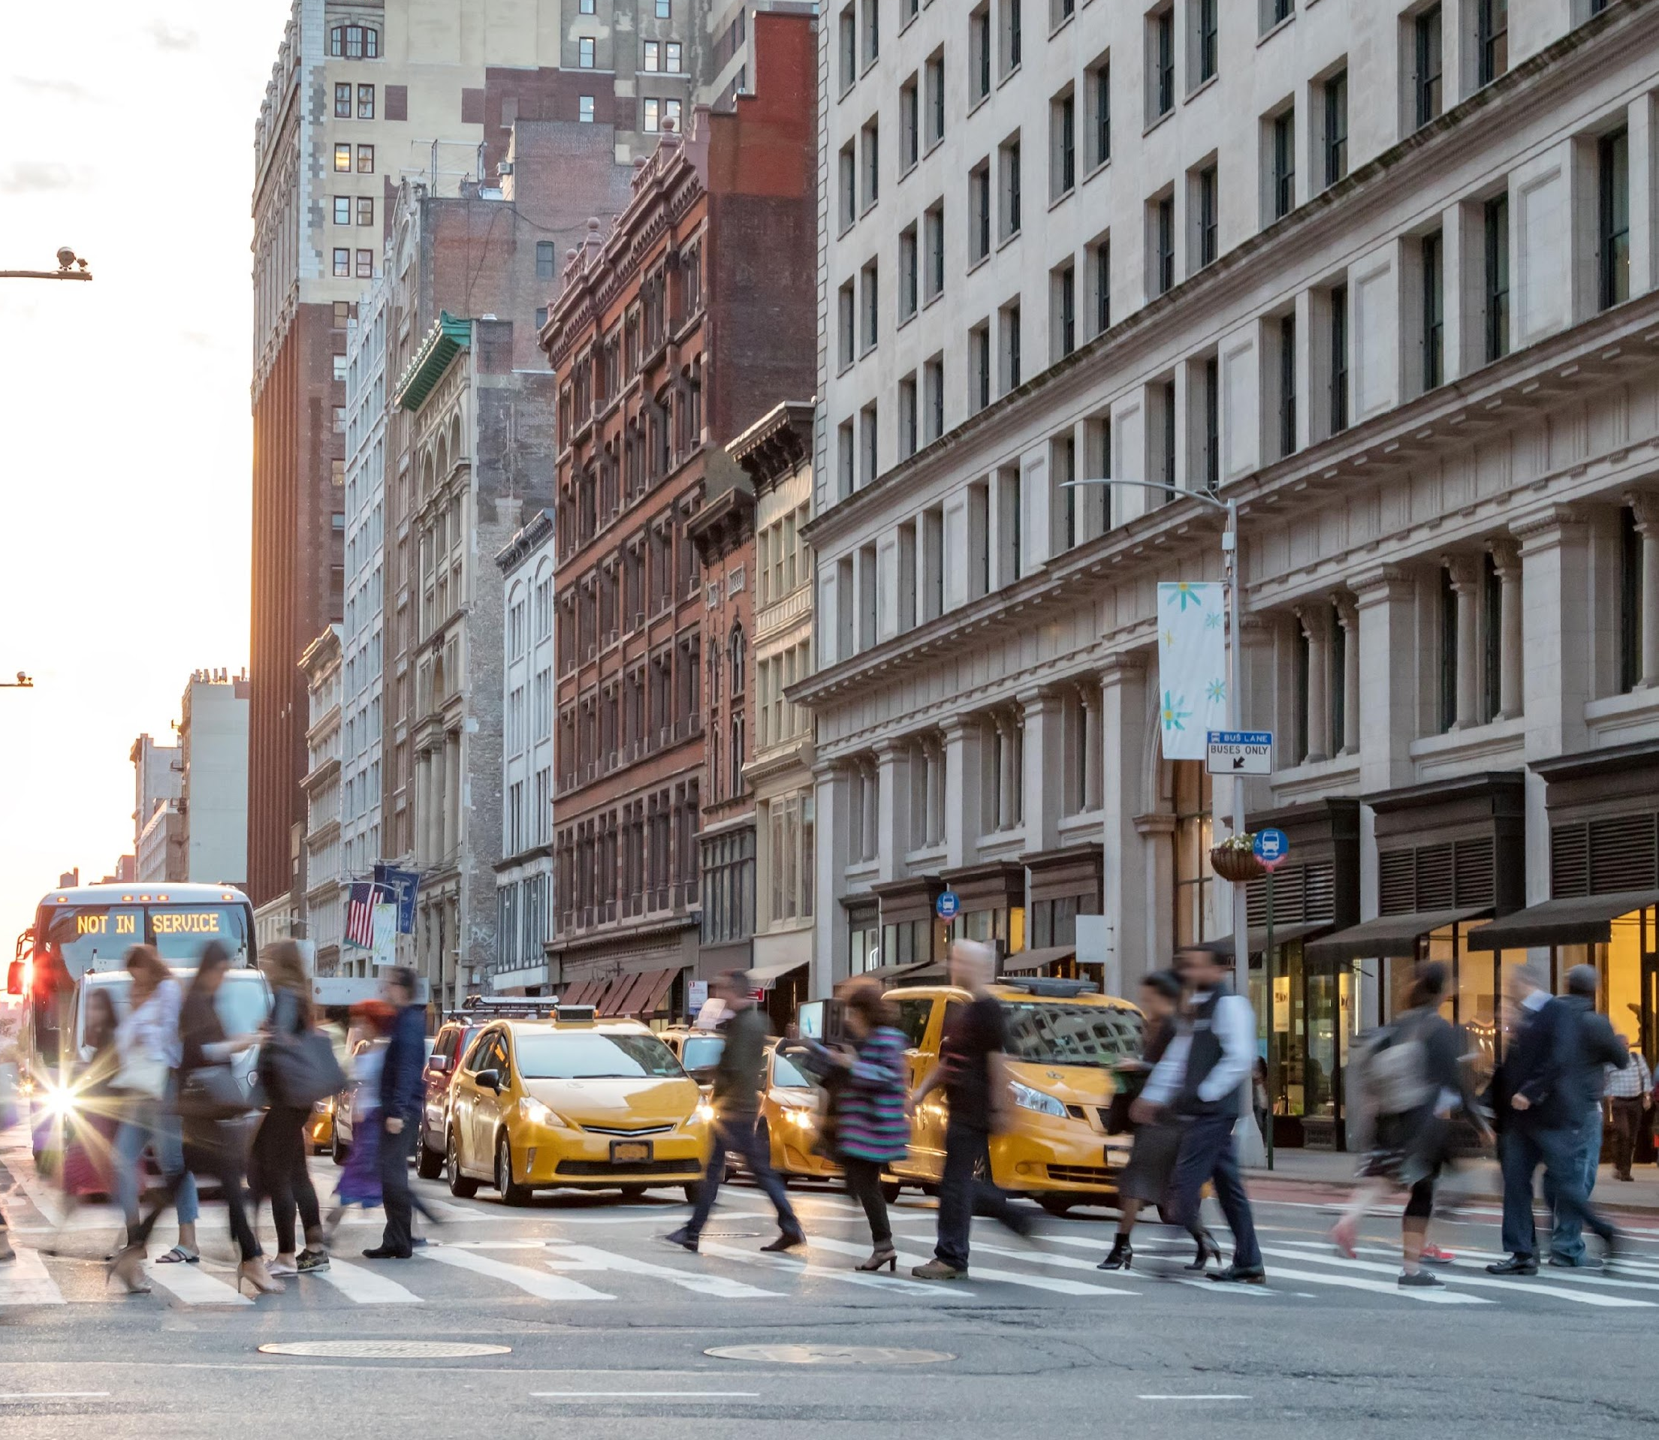
Living in New York City
Home to thousands of multinational companies
Important industries and landmarks
Living laboratory for students
Broadway theater and great museums
24,000+ restaurants
Notes:
[Note- slides re living in NYC comes first]

Slide 15
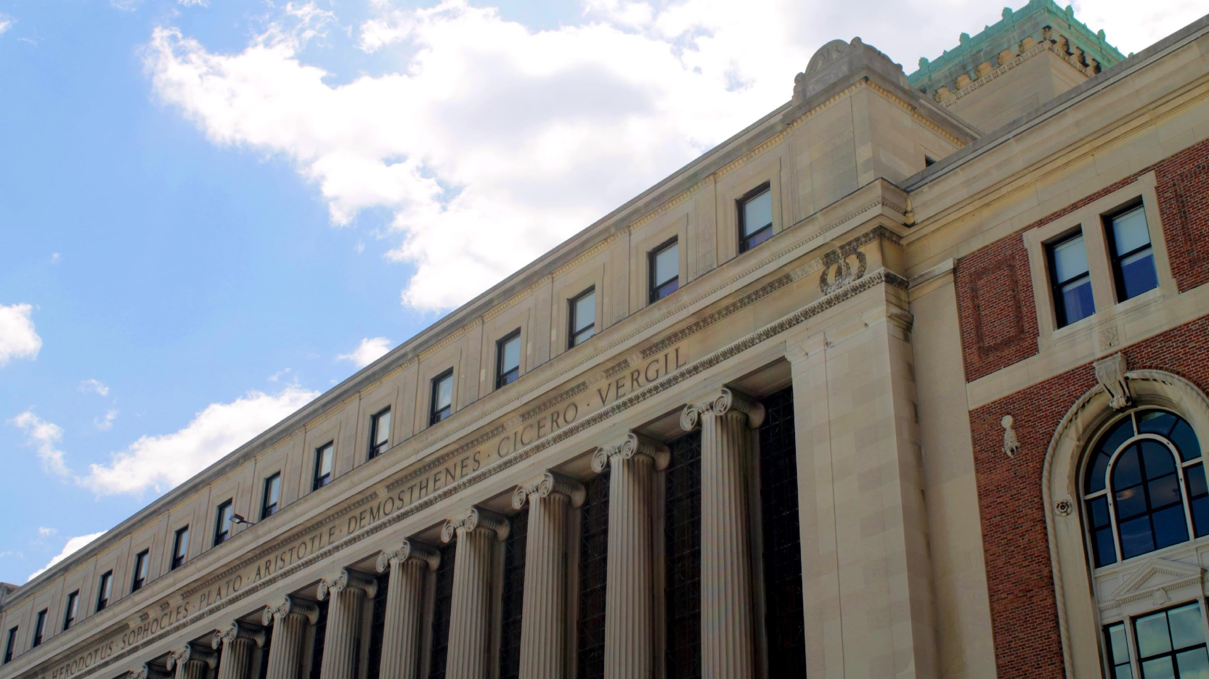
Libraries
18 libraries
Use of computers, copiers and printers
Study spaces
For more info, go to: library.columbia.edu

Slide 16
Housing
On-Campus housing is available for summer visiting students.
For more information, visit: housing.columbia.edu

Slide 17
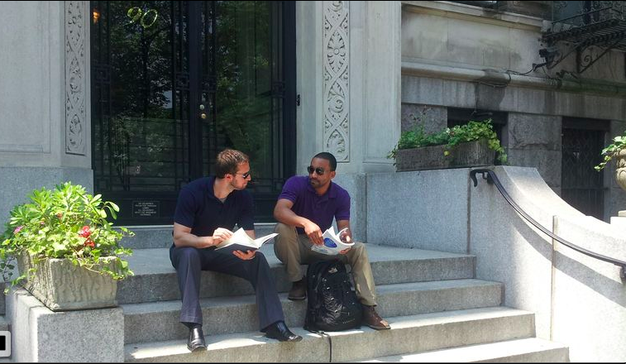
Off-Campus Housing Assistance
ocha.facilities.columbia.edu
Telephone: 212-854-2773
401 West 119th Street
Open Monday through Friday, 9:00–5:00 PM
Notes:
Alternatively, Columbia's Off-Campus Housing Assistance (OCHA) assists Columbia students and affiliates in their search for rental housing in the metropolitan area. OCHA manages a database known as the Housing Registry which includes available rooms and apartments in non-Columbia-owned buildings as well as sublets of units in Columbia-managed housing.
Prospective roommates can also post and search profiles on this site. In addition, the service offers housing search counseling. For more information please visit their website.

Slide 18
Questions?
More information available:
summer.sps.columbia.edu
212-854-9666
summersession@columbia.edu
Notes:
We will now move on to the live Q&A portion of our presentation. I encourage you to take advantage of this time to ask the Program team any questions that may not have been answered.

